Slide 1
Microsoft Power Platform + Dynamics 365
Notes:
Hi, Welcome to Microsoft Power Platform + Dynamics 365 Bootcamp.

Slide 2
Course Overview
Day 1 – Part I
Empowering Everyone with Power Platform – From CEO to Frontline Workers
Introduction to Power Platform
Day 1 – Part II
Power Packed Day with Power Canvas Apps
Introduction to PowerApps
Day 2– Part I
Power Packed Day with Power Model Driven Apps
Let’s talk about data
Day 2– Part II
Power Packed Day with Power Automate
Introduction
Day 3– Part I
Power Packed Day with Power Agents
Introduction
Microsoft Power Platform momentum
Why Power Platform?
Customer Stories
Demo
Benefits of PowerApps
What can I build with PowerApps?
Types of PowerApps
Canvas Apps
Data Sources and Connectors
Demo
Types of Data
Common Data Service
Model-driven Apps
What type of components can I add?
Data model design
Demo
Types of flow
Data types and expression
Working with Arrays
Control flow and action settings
Demo
A Robust Virtual Agent Platform
Converse everywhere
Easily make your bots better
Create personalized customer experiences
Transfer to a human agent
Built on Power Platform & Azure Bot Service
Extend your bot capabilities with Azure Bot Service
Demo

Slide 3
Continue…
Day 3 – Part II
Power Packed Day with Power BI
Introduction
Day 4– Part I
Power up your Apps with AI Builder
Introduction
Day 4– Part II
Power Platform Administration, Security & Integration Connectors
Introduction
Day 5– Part I
Power Packed Bizz Apps Day – Sales & Marketing
Introduction
Day 5– Part II
Power Packed Bizz Apps Day– Finance & Supply Chain
Introduction
AI for every app. And everyone
Setup Environment
Types of AI Model
Prediction
Form processing
Object detection
Text classification
Demo
The 5x5 Principle
Customer momentum: Power BI
Power BI Desktop
Data sources
Power Query
Dataflow
Using a Calculation (DAX) in multiple files
Paginated Reporting
Power BI Admin Portal
Demo
Secure your tenant
Monitor your tenant’s activity
Alert & act on that activity
Connectors
SharePoint Integration
Demo
Nurture more demand
Personalize buyer experiences
Build relationships at scale
Make insight-driven decisions
Demo
How to embed Power BI in Dynamics 365 for Sales and Marketing
Technology Modernization
Modern Finance
Supporting modern supply chain management
Demo
How to embed Power Platform in Dynamics 365 for Finance and Supply Chain

Slide 4
Day 5: Power Packed Bizz Apps Day – Sales & Marketing – Part I

Slide 5

Agenda
Introduction
Nurture more demand
Personalize buyer experiences
Build relationships at scale
Make insight-driven decisions
Demo
Create new app using existing solution Sales and Marketing
How to embed Power BI in Dynamics 365 for Sales and Marketing

Slide 6

The world’s connected AI business cloud
Sales
Marketing
Talent
Service
Finance
Commerce
Operations
Dynamics 365 & Power Platform
Notes:
With connected data and applied intelligence at the core, Dynamics 365 and Power Platform form the basis of the most comprehensive set of connected, intelligent business applications in the world today
From sales, to finance, to talent management and more, customers need a deep understanding of their business in order to succeed – not just in one department, but across everything
With Dynamics 365, we have the unique ability to bring together data from virtually any source, whether it’s a Microsoft system or not and bring it into this connected digital feedback loop
Built on hyperscale cloud platform with Azure, with inherent intelligence at app layer
Allowing everyone to analyze, act, automate with Power Platform
T: To do this, we need a multifaceted set of solutions

Slide 7

Customer expectations are growing
of consumers are more likely to shop with brands who recognize, remember, and provide relevant offers and recommendations. ¹
91%
of buyers want brands to get to know them and understand when to approach them and when not to. ²
81%
¹ Accenture
² Accenture
Notes:
Expectations
Let’s start by looking at customer expectations today.
91% of buyers are more likely to shop with brands who recognize, remember, and provide relevant offers and recommendations
81% of buyers want brands to get to know them and understand when to approach them and when not to
The expectations are high and increasing. Power, as we know, has officially shifted to the customer, who expects seamless customer experiences across all platforms and devices.
Customers believe that they have a relationship with companies. They believe they should be recognized by the company, and the experience should be mutually beneficial, and therefore designed with them in mind — similar to most relationships: If the company collects my personal data, then they should at least use all that data to understand me before they interact with me.

Slide 8

Today’s experiences are falling short
65%
of consumers are frustrated by inconsistent experiences across channels. ¹
of customers are frustrated by the irrelevant content they are exposed to on websites. Up to 40% of them will leave. ²
74%
of customers stopped doing business with at least one company last year because of poor customer experience. ³
61%
¹ McKinsey
² Accenture
³ Accenture
Notes:
Reality
But today’s experiences are falling short of customer expectations.
65% of customers are frustrated by inconsistent experiences across channels
74% of customers are frustrated by the irrelevant content they are exposed to on websites. Up to 40% of them will go so far as to leaving
61% of customers stopped doing business with at least one company last year because of poor customer experience
Customers will not tolerate companies that have amnesia when it comes to remembering them and their preferences. We are living in a market where customers are increasingly free agents and where adoption and abandonment occur at the blink of an eye. It is imperative for companies to recognize their customers and to deliver a personalized experience that demonstrates they understand and value their customers. Today’s customers do not buy just products or services. More and more, their purchase decisions revolve around the experience. This heightened expectation gives rise to new challenges for organizations.

Slide 9


APPS AND CHANNELS OF ENGAGMENT
360 degree view of customers
5-10%
increase in revenue¹
TRANSACTIONAL
BEHAVIORAL
DEMOGRAPHIC
Close the gap by activating data to gain insights
15-25%
decrease in costs¹
¹ McKinsey
Notes:
Closing the gap
Companies that create exceptional customer experiences can set themselves apart. This is where data comes in. Now more than ever, customer data holds the key to providing a superior customer experience. Organizations that harness customer data for insights achieve:
Revenue gains of 5-10%
Reduce costs by 15-25 % within two or three years
In the new digital economy, customer data reigns as the competitive differentiator of market success. Yet while data is key, many organizations are still mired in outdated methods, processes, and technology. Companies that are not adapting are finding their revenue and growth precipitously eroding as data-savvy competitors offer more personalized experiences that customers expect.
While business leaders recognize that they must move fast to become customer-data-driven enterprises, they’re nowhere close to the finish line. The good news is that much of the data is already being collected by organizations today. The bad news is that this data is typically maintained in separate systems, across organizational silos, and often cannot be surfaced at the time it’s needed to contribute to, or enhance, the customer experience.
With Microsoft, it’s now possible for companies to unify customer data across all sources, gain a 360-degree view of customers, and unlock insights that power personalized, memorable experiences across channels.

Slide 10

Vision
Empower every organization to unify and understand its customer data to derive insights that power personalized experiences and processes
Notes:
Dynamics 365 Customer Insights unifies B2C and B2B customer data and provides the insights to enable organizations to deliver personalized customer experiences. Microsoft helps organizations realize the full potential of their customer data quickly with the only self-service solution that enriches customer data and lets organizations maintain full control over the customer data for data security, governance, and compliance.

Slide 11



Our approach
Internal | External
Contacts | Partner data
POS | Events
Cases | Loyalty
Campaigns | Geo
Web | WIFI
Email | Social
Mobile | LinkedIn
Power BI
Microsoft Flow
PowerApps
Process optimization and automation
Mobile
Web
Social
Bots
In-person
Channels of engagement
TRANSACTIONAL
BEHAVIORAL
Ingest
DEMOGRAPHIC
Map and Match
Analytics
CONNECTORS
Conflate
Enrich
AI and ML
Data
Unification
Insights
Action
Notes:
Microsoft’s prepackaged, business-managed solution makes customer insights a reality for organizations of all sizes. The solution automates the orchestration of customer data and ultimately empowers employees to connect and engage with customers in the moment. Organizations can obtain a truly complete view of each customer across channels – from campaign responses, website visits, in-store visits and purchases, online purchases, loyalty redemptions, customer service encounters, or social interactions. The solution enables administrators to bring in customer data from various sources with ease, whether the data resides in transactional or behavior or internal or external data sources. Additionally, the solution standardizes the data and applies built-in AI to automatically match and merge the customer records into one comprehensive customer profile. In addition, organizations can create richer profiles with brand affinity and interests from Microsoft Graph which provides aggregated proprietary predictive signals. With accessible, persistent, and up-to-date customer data, the entire organization has a single source of truth on top of which analytics, AI, and ML can be applied to derive insights and KPIs that power personalized experiences and optimize business processes across all channels of engagement.

Slide 12



Power end-to-end customer experiences
Sales
Lead generation
Cross-sell/upsell
Omni-channel support
Campaigns
Next best action
Website
Recommendations
Marketing
Content
Service
Notes:
With Customers Insights, organizations gain deeper insights about customers which drive personalized business processes and experiences across marketing, sales, and service. Here are some examples of the scenarios that customer insights can enable:
Marketing scenarios:
Lead gen – increase conversion by focusing on your best prospects; enrich customer data with external data such as brand affinity or preferences to better predict which prospects are most likely to convert
Campaigns/segmentation – create more accurate and micro-targeted segments to better reach prospects and customers; send segments to executional tools for email campaigns, mobile messaging, etc.; use a combination of events, location, user profile attributes, and historical data from Customer Insights to deliver personalized information, content, and offers
Website/content personalization – surface personalized and relevant content to develop an authentic and emotional connection with customers
Sales scenarios:
Product recommendations – provide customers with sophisticated recommendations for complementary products or services instead of just the things the customer has already browsed or bought
Next best action – surface the next best action for salespeople so they can engage with confidence
Service use cases:
Proactive, omni-channel support – democratize data and empower front-line employees to make decisions, e.g. having a 360-degree view of the customer enables the agent to make calculated exceptions for high-value customers; by utilizing rich and robust customer profiles generated by Customer Insights, call center agents can deliver not only personalized, but also consistent, interactions which leave customers with a sense of being valued and understood
Cross-sell/upsell – recommend products and services that are a better fit for customers

Slide 13
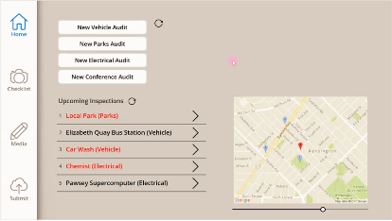
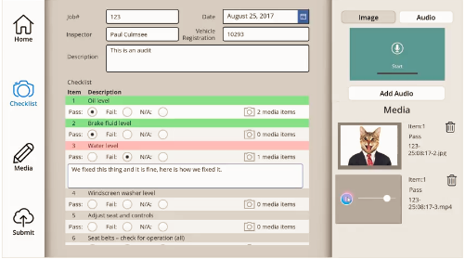

Field Service – Audit App Power Platform use cases
Site visits & audits:
Checklists
Voice recording
Image uploads

Slide 14
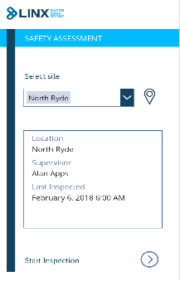
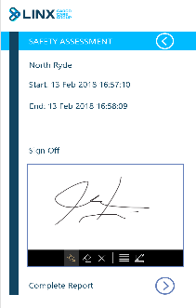
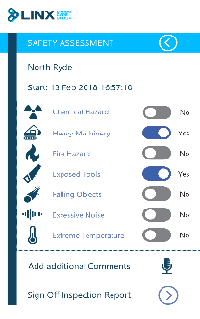
Field Service – Security Assessment App Power Platform use cases
Site visits & audits:
Checklists
Signatures
Logic & rules

Slide 15
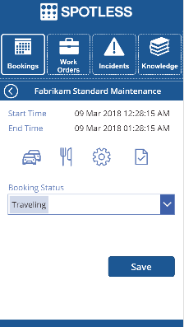
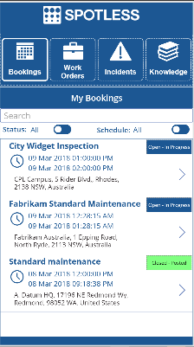
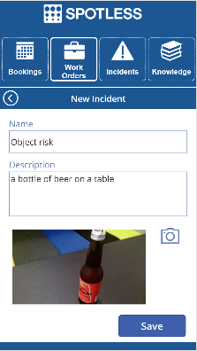
Field Service – Enhancement App Power Platform use cases
Manage risks:
Status updates & incident reports
Enriched location mapping
Image analysis
Uses Dynamics Field Services, Bing Maps services & Computer Vision API

Slide 16
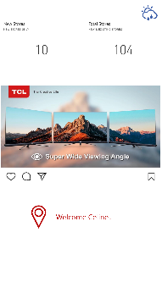
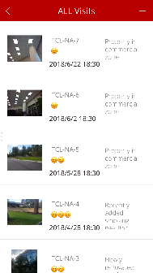
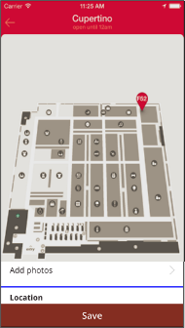
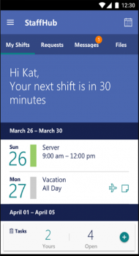
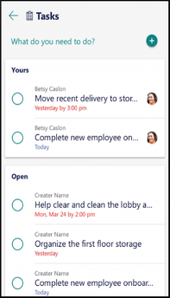
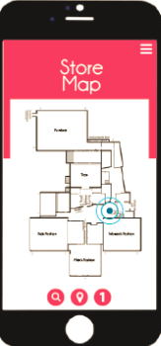
Retail – Store Visit App Power Platform use cases
Phone App
All Visits
Store Location
Resourcing
Actions
Rep Location

Slide 17

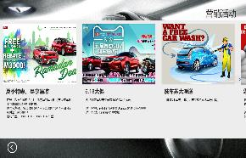
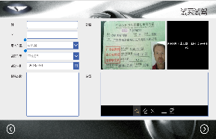
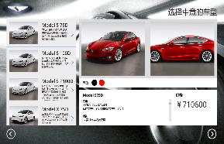
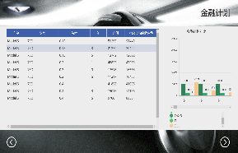
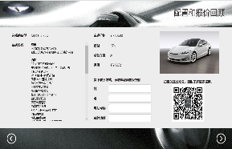
Manufacturing – Car Maker Power Platform use cases
Personalized Selling
Recognize
Profile
Recommend

Slide 18
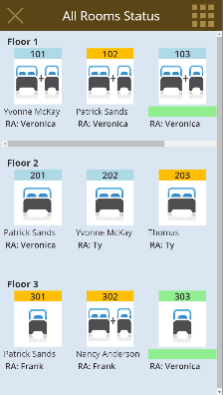

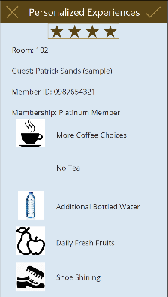

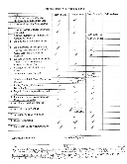

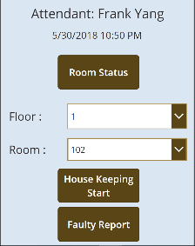
Hotel – Personalized Services Power Platform use cases
Log
Lindsay Gill
Attendant
5/30/2018 10:50PM
Personalized customer experiences
Digitized
Modern
Personalized

Slide 19

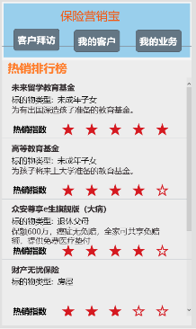
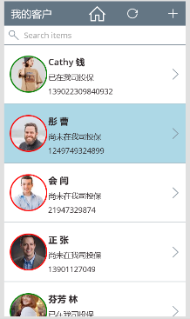
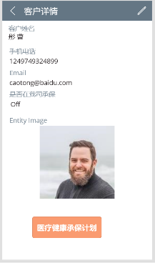
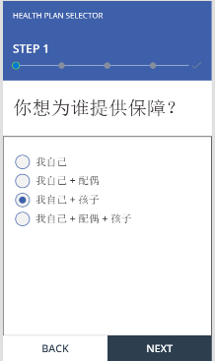
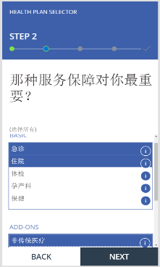
Insurance – Agent Assistant App Power Platform use cases
Smarter sellers
Intimate
Personalized
Intelligent

Slide 20
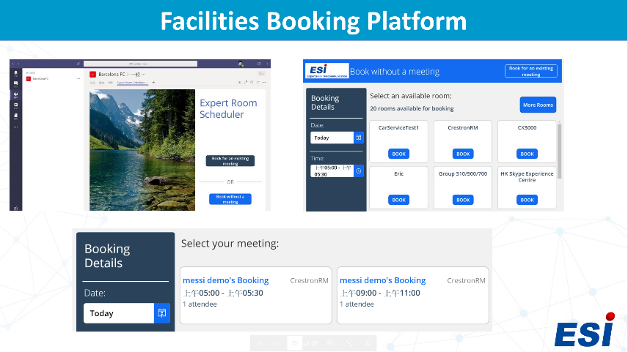
Telco – Facilities Booking Platform Power Platform use cases
Optimizing resources
Easy
Workflow
Intelligent

Slide 21

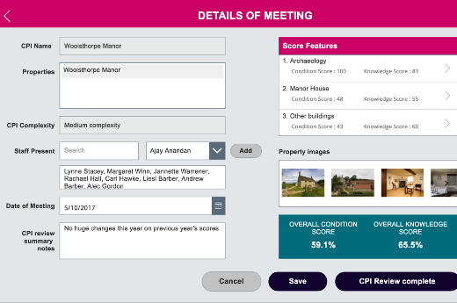




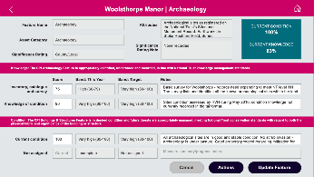
Professional Services – Property Management Power Platform use cases
360° Management:
Trends
Intelligent
Prevention

Slide 22

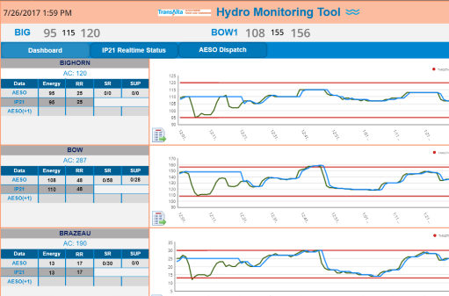

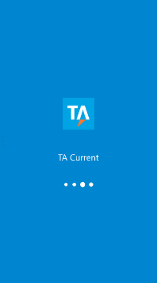

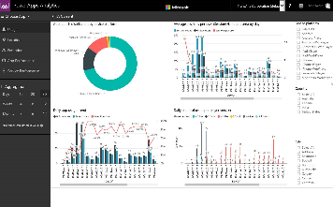
Utilities – Power Grid Management Power Platform use cases
360° Management:
Trends
Intelligent
Prevention

Slide 23

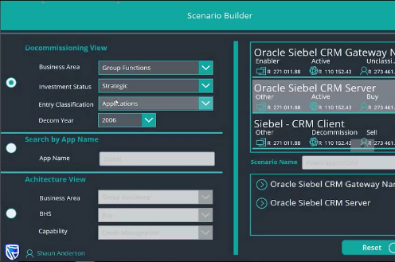

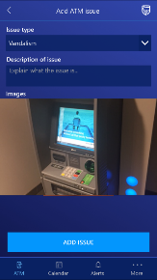
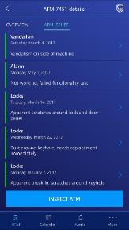

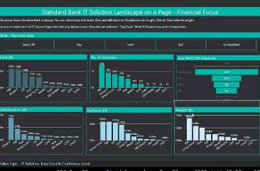
Utilities – Power Grid Management Power Platform use cases
Risk Management:
Paper to apps
Business process management

Slide 24
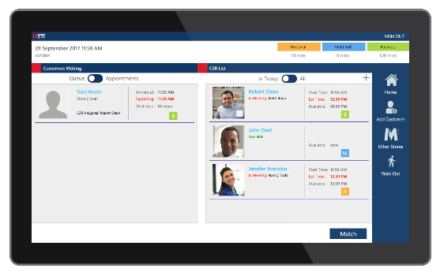

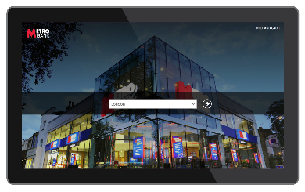
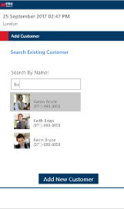
Bank – VIP Relationship Management Power Platform use cases
Personalized relationships
Predictive
360°

Slide 25
Research
Discover relevant news and insights
Stay on top of essentials
Email alerts
Track and prioritize leads
Multiple lead-scoring models
Sales readiness grades
Smart scheduling
Handoff to sales
Pre-made workflows
Unified data across contacts, leads, and customers
Campaign asset creation
Emails
Web landing pages
Event management
Social media integration
Dismiss lead
Lead scoring
Predictive lead scoring and prioritization models
Nurture leads
Personalized, account-based content
Customer journey designer
A/B testing
Dynamic segmentation
Customer interaction insights
Surveys
Customer interactions
Warm introductions
Recommended, personalized talking points and actions
AI-driven next best actions
Personalized sales documents
Showcase product with mixed reality
Customer Data Platform
Data ingestion
Data unification
AI-driven segmentation
Intelligent Sales & Marketing
Manage relationships
Relationship assistant
Health and risk scores
Interactive org charts
Positive outcome
Actionable insights
Supervisor review
Pipeline analysis
Relationship and conversational intelligence
Coaching and training opportunities
Data capture
Win deal
Document sharing
Leveraging winning sales techniques
Negative outcome
Survey distribution
Automated, personalized surveys

Slide 26
Research
Discover relevant news and insights
Stay on top of essentials
Email alerts
Track and prioritize leads
Multiple lead-scoring models
Sales readiness grades
Smart scheduling
Campaign asset creation
Emails
Web landing pages
Event management
LinkedIn integration
Social media integration
Nurture leads
Personalized, account-based content
Customer journey designer
A/B testing
Dynamic segmentation
Customer interaction insights
Surveys
Customer Data Platform
Data ingestion
Data unification
AI-driven segmentation
Nurture more demand

Slide 27

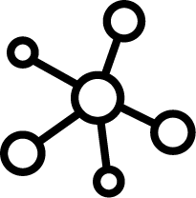
Build richer, more holistic views of your customers, unlock insights and take action
Create emails, landing pages and event web portals that display content personalized for contacts.
Discover, track, and quickly react to key events, trends, and indicators that are most relevant to your business
Create and customize multi-channels campaigns specifically for your audience
Track and prioritize leads across all touchpoints with multiple lead-scoring models and sales readiness grades
Nurture more demand

Slide 28

Get a holistic view
of customers
Dynamics 365 Customer Insights
Unlock insights and take action
Adapt and extend
Rely on a productive
and trusted platform
Notes:
To compete in today’s market, B2C and B2B organizations need to build meaningful relationships with their customers on a personal level. The ability to effectively personalize at scale requires a complete, unified view of customers. Unified customer data incorporates transactional data like online/offline purchases and behavioral data like social media activities, website interactions, offer engagement, and help desk interactions. When brought together, the data becomes an asset from which insights are derived. With Customer Insights, organizations can finally deliver personalized experiences through 1:1 interactions, relevant offers, or product recommendations, all at the right time and right place/device. Let’s look at each of these pillars in more detail.

Slide 29
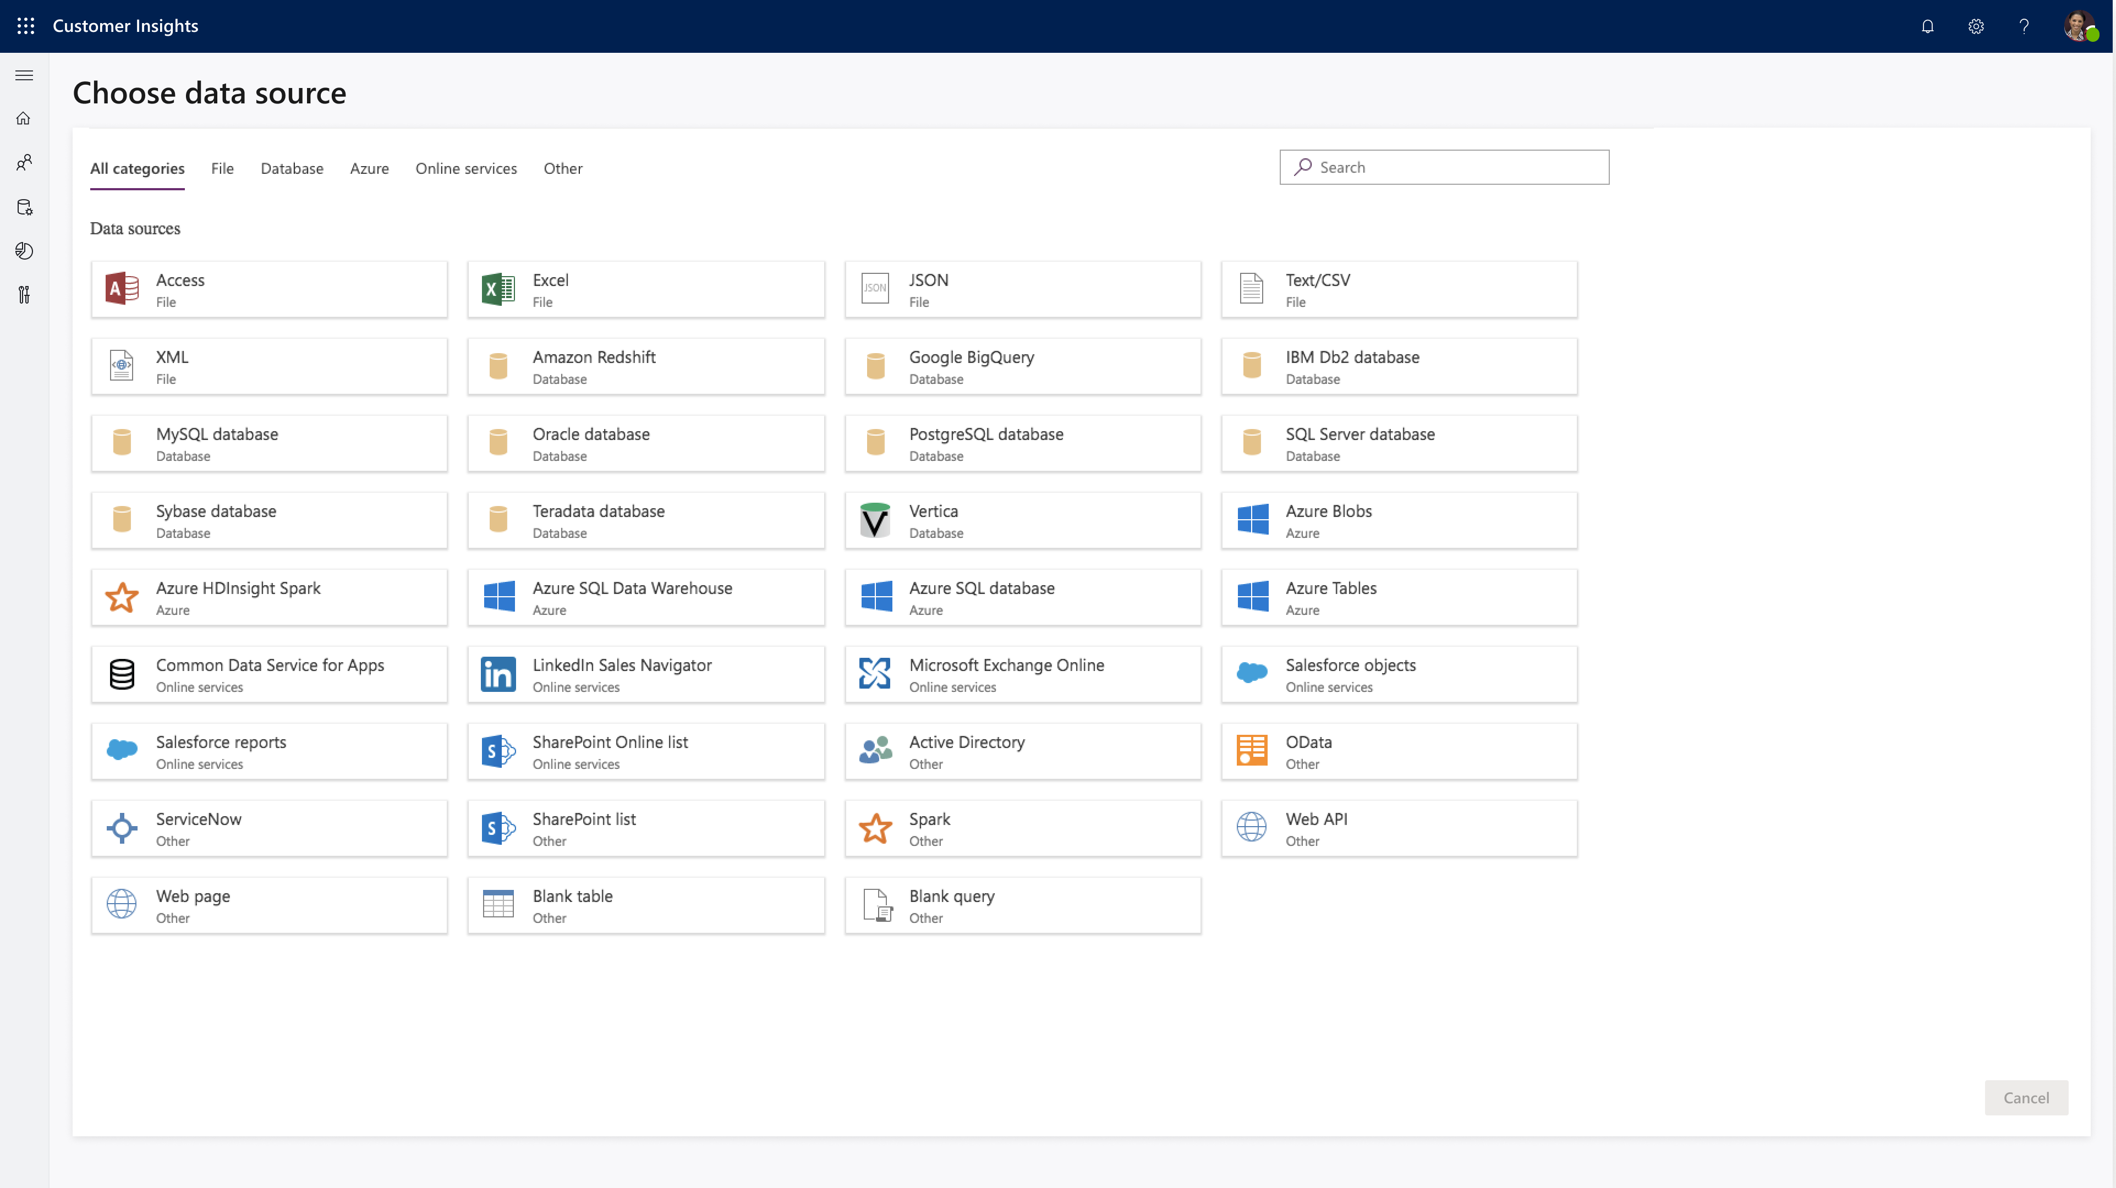
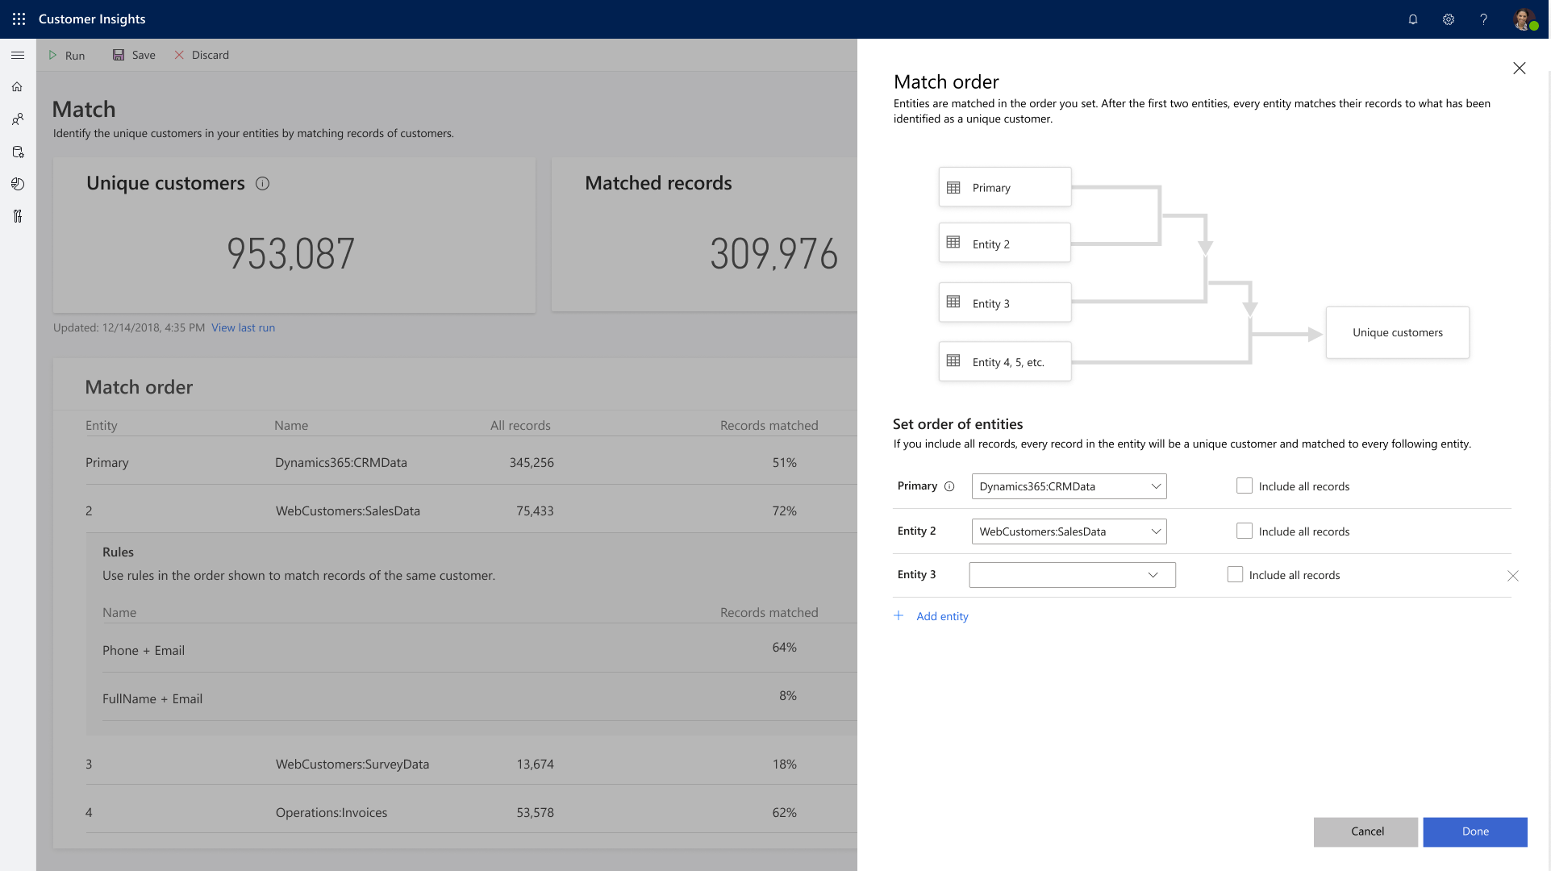
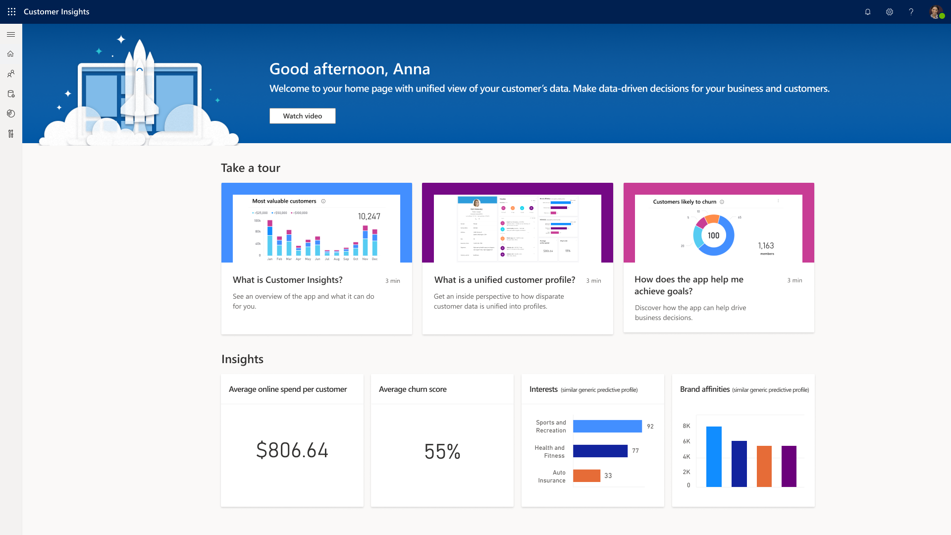
Get a holistic view of customers
Connect your data with ease
Transform customer data intelligently
Enrich data
Notes:
It all starts with data. To get a holistic view of customers, organizations need to:
Connect your data with ease, whether it’s data for contacts or accounts - Bring in all your transactional, observational, and behavioral data from popular data sources by leveraging prebuilt connectors.
Transform customer data intelligently – Unify data by intelligently resolving customer identifies with AI/ML-driven recommendations.
Enrich data – Build richer customer profiles by incorporating audience intelligence contained within the Microsoft Graph.

Slide 30
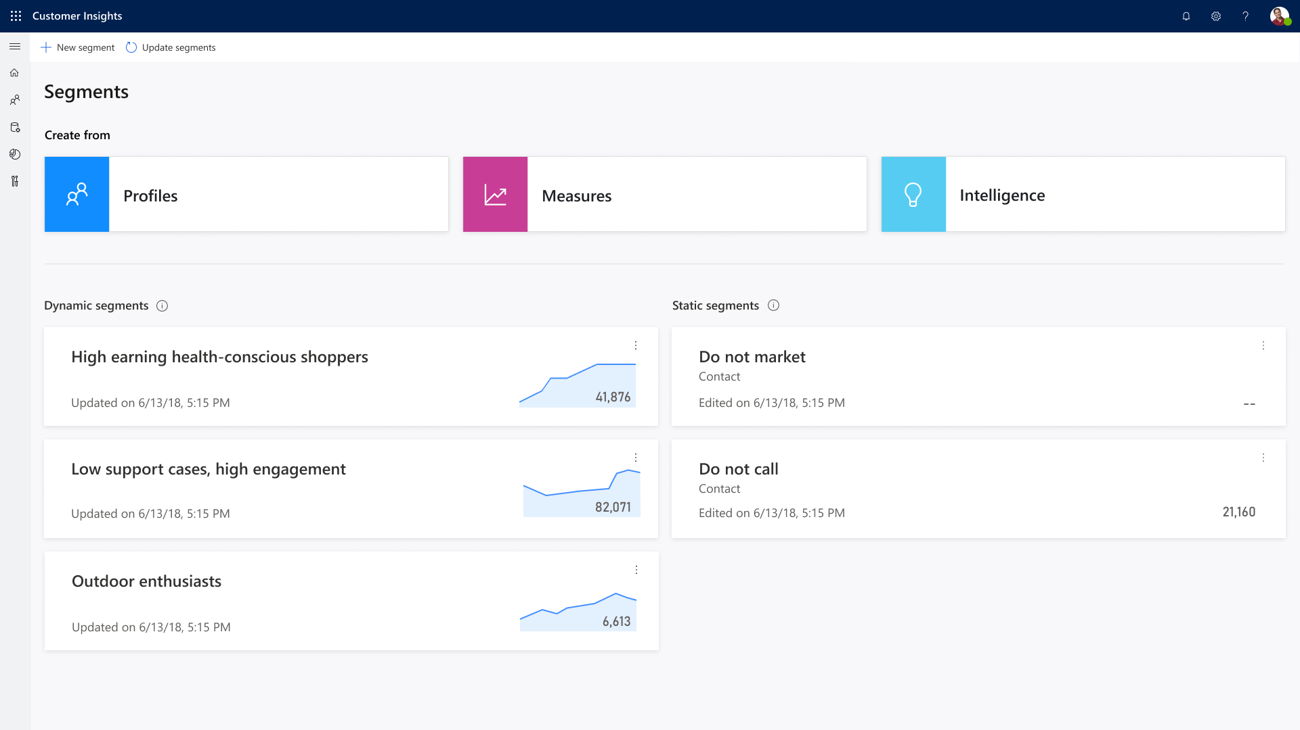
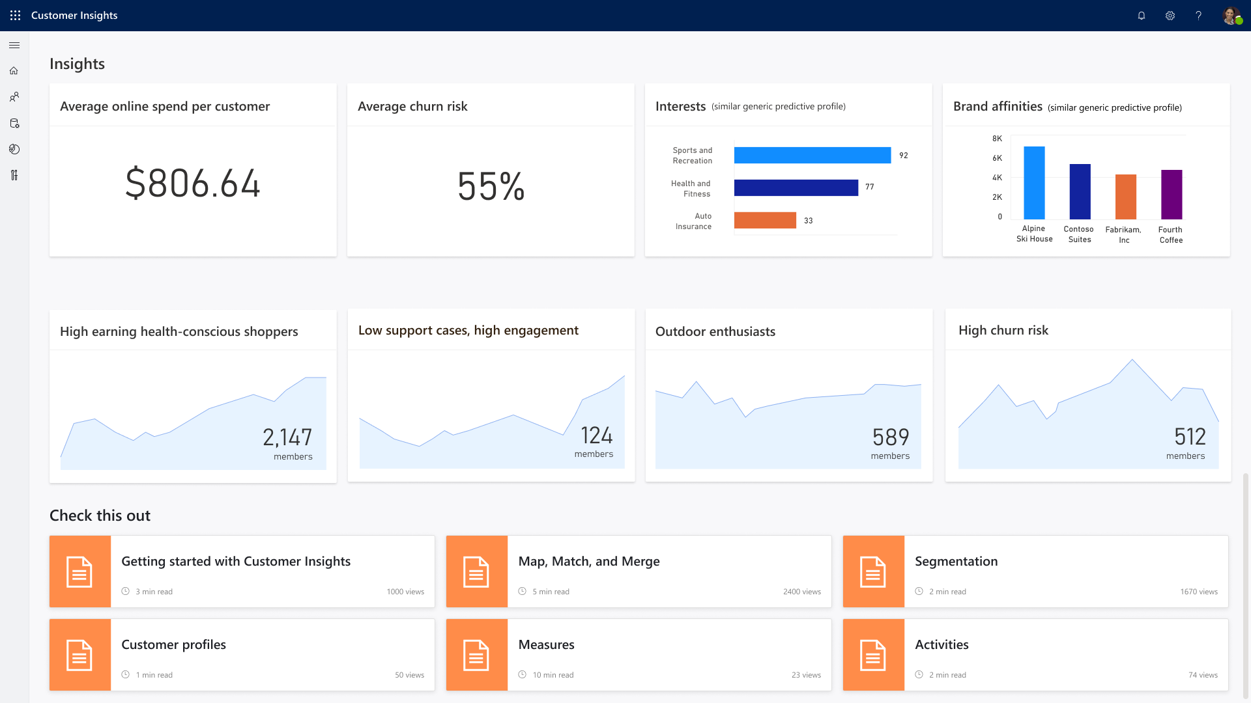
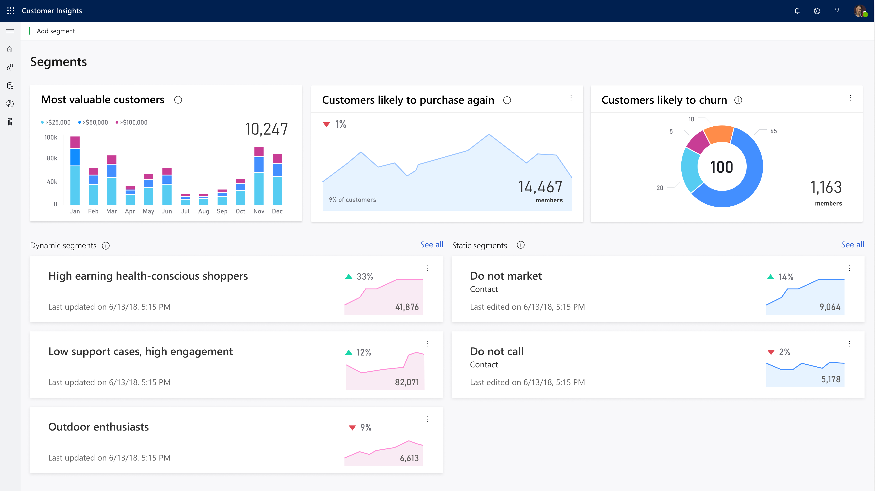
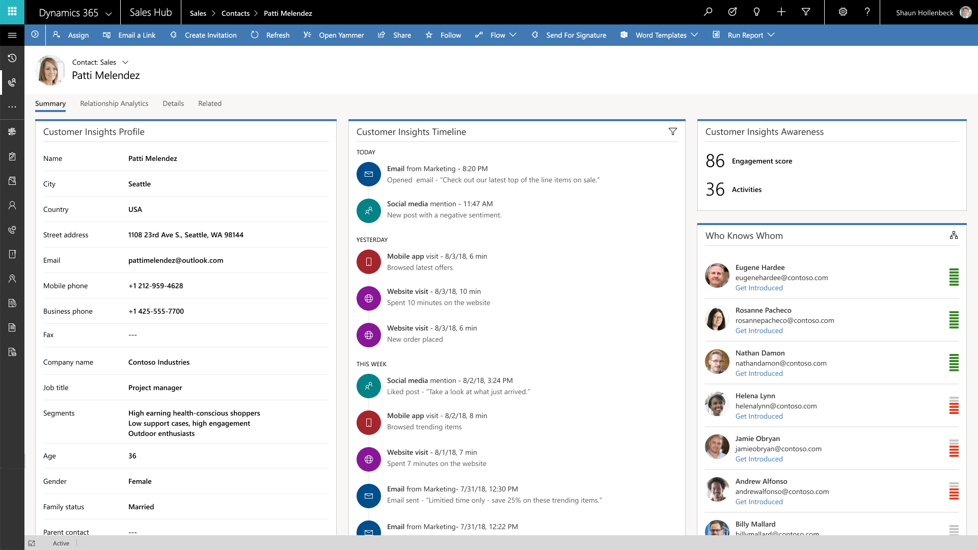
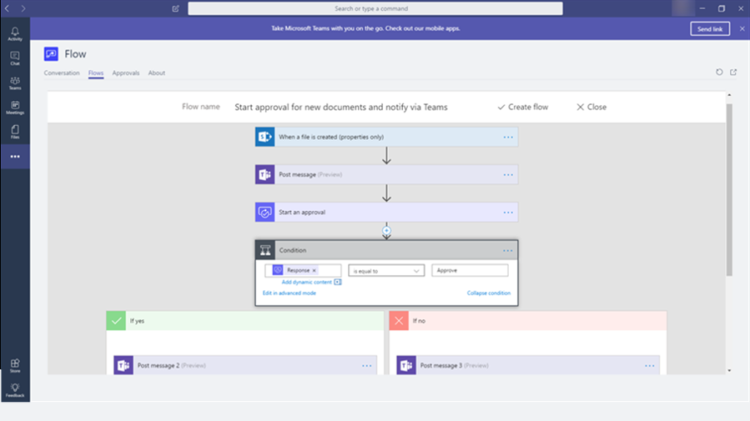
Unlock insights and take action
Predict customer intent
Spot trends and patterns
Create richer customer segments
Drive personalized experiences across channels
Automate customer-centric experiences and processes
Notes:
Unlock insights and take action
Predict customer intent – Leverage quick-start machine learning templates to predict churn or next best action.
Spot trends and patterns – Gain customer insights with configurable metrics and KPIs.
Create richer customer segments – Easily discover and create new audience segments to deliver targeted messages and content. Find recommended segments based on AI.
Drive personalized experiences across channels – Empower marketing, sales, and service professionals with contextual customer insights and tailored customer profile cards infused into the business applications they already use every day.
Automate customer-centric experiences and processes – Trigger workflows in response to customer actions and signals in real-time using Microsoft Flow.

Slide 31




Adapt and extend
Gain deeper insights
Connect to custom apps
Innovate and evolve
Notes:
Adapt and extend
Gain deeper insights – Seamlessly connect customer data with Power BI to customize dashboards and reports that enable informed decision-making.
Connect to custom apps - Quickly build custom apps with embedded customer insights using a powerful, click-and-point approach from PowerApps.
Innovate and evolve – Organizations can get up and running fast with a prebuilt CDP solution, yet the solution is flexible and fully extensible using familiar and powerful services and tools in the Azure platform. If there’s a need to customize ML to address specific business needs, organizations have the ability to fully extend and customize ML using Azure Machine Learning.

Slide 32



Rely on productive and trusted platform
Get started quickly
Maintain control of your data
Invest with confidence
Notes:
Rely on a productive and trusted platform. Leaders need to eliminate anything that jeopardizes trust. They make digital trust sustainable by establishing a rigorous process and governance structure. Most important, they manage digital trust as the critical growth enabler it is.
Get started quickly – Shorten time to value with a ready-to-go, self-service customer data platform solution built on the Azure cloud platform. Flexible deployment options allow you to bring your own Azure data store for data ingestion and storage of unified data.
Maintain control of your data – Help your business support data privacy and GDPR compliance with enterprise ready security and built-in governance tools while retaining full access to your customer data.
Invest with confidence - Put your trust in Microsoft’s expertise and experience in world-class AI research, cloud, data and developer platform.

Slide 33

Dynamics 365 Dashboard

Slide 34

Power BI Dashboard in Dynamics 365

Slide 35
Handoff to sales
Pre-made workflows
Unified data across contacts, leads, and customers
Dismiss lead
Personalized buyer experiences &
Build relationships at scale
Lead scoring
Predictive lead scoring and prioritization models
Customer interactions
Warm introductions
Recommended, personalized talking points and actions
AI-driven next best actions
Personalized sales documents
Showcase product with mixed reality
Manage relationships
Relationship assistant
Health and risk scores
Interactive org charts
Win deal
Document sharing
Leveraging winning sales techniques

Slide 36


Improve conversion and win rates with lead and opportunity scoring based on advanced scoring models
Enable smart selling with actionable insights and AI-driven next best action recommendations
Enhance sales productivity, find stakeholders & decision-makers with connected tools
Enhance buying and sales experience by showcasing products with mixed-reality
Personalize buyer experiences
& Build relationship at scale

Slide 37


Lead scoring
Dynamics 365 Sales Insights:
Predictive scoring
Scoring model to generate scores and to identify and prioritize leads that have more chances of converting into opportunities
Provides a list of leads with different parameters including lead score, lead grade, and lead score trend
Get the list of opportunities with different parameters, including opportunity score, opportunity grade, and opportunity score trend
Predictive opportunity scoring model to focus sales efforts on opportunities that are more likely to convert into deals

Slide 38



Customer interactions
LinkedIn Sales Navigator:
Understand your audience
Get profiles and data integrated in Dynamics 365 for Marketing, including related leads
Understand what customers are interested in through the content they share on LinkedIn
Receive alerts in real time when leads change jobs, connect with someone in their network, or are mentioned in the news
Get embedded insights that reveal the next best action based on a customer and their interaction data from LinkedIn, Dynamics 365, and Office 365
Send InMail, messages, and customized connection requests from Dynamics 365

Slide 39


Customer interactions
Dynamics 365 Sales Insights and Teams:
Action recommendations
Use Assistant Studio to enforce best practices and guide sellers along a path to close deals faster and increase revenue
Get embedded insights that reveal the next best action to move sales relationships forward based on customer interaction data from LinkedIn, Dynamics 365, and Office 365
Analyze conversations across multiple channels with Conversation Intelligence to give sellers insights about how to improve over time
Even access your Sales Hub data and get action recommendations while you're on the go using Dynamics 365 Teams app on your mobile device

Slide 40


Customer interactions
Dynamics 365 Sales Insights:
Who Knows Whom
The Who Knows Whom features calculates relationships from the communication and collaboration patterns of users in your Microsoft Exchange environment
Provides you with details such as colleague names and email addresses who know the lead and can introduce leads or contacts
This feature is available in contact and lead forms. When you open a lead or contact and select the Sales Insights view, the Who Knows Whom tile is displayed
Increase sales performance to improve lead-to-opportunity conversion rates and help close more deals

Slide 41


Manage Relationships
Dynamics 365 Sales Insights:
Relationship analytics
Assemble relevant information from a database to create a graphical display of KPIs, health scores, health trends, and activity histories for contact, opportunity, lead, and account records
The relationship pipeline view in form of a bubble chart displays health, close date, and estimated revenue for your upcoming opportunities

Slide 42
Make insights driven decisions
Customer Data Platform
Data ingestion
Data unification
AI-driven segmentation
Positive outcome
Actionable insights
Supervisor review
Pipeline analysis
Relationship and conversational intelligence
Coaching and training opportunities
Data capture
Negative outcome
Survey distribution
Automated, personalized surveys

Slide 43


Understand customer needs and provide sellers with valuable feedback by creating and sending surveys to your customers
Learn from your sales calls with conversational intelligence: analyze customer emotion, sentiment, conversation content, and speaking style.
Increase sales performance and ramp sellers faster with AI-driven insights
Stay ahead of the market with insights that are derived from brand and competitor mentions.
Make insights driven decision

Slide 44


Surveys
Dynamics 365 Forms Pro:
Improve your sales process
Understand customer needs better and provide sellers with valuable feedback by creating and sending surveys to your customers
Distribute surveys by using email, Microsoft Flow, embedding it in web page, or generating a QR code
Leverage built-in analytics to evaluate responses or create custom analytics using Power BI

Slide 45

Actionable insights
Dynamics 365 Sales Insights:
Make strategic decisions
Conversation Intelligence analyzes conversations across multiple channels to give you insights about how to improve over time.
AI models for emotion detection offer granularity to give you a unique understanding of customer sentiments during calls.
Increase sales performance and ramp sellers faster with AI-driven insights that help busy sales leaders proactively flag at-risk deals, gain visibility into conversations, and provide actionable feedback through built-in coaching tools.
Stay ahead of the market with insights that are derived from brand and competitor mentions.

Slide 46

Demo
Create new app using existing solution Sales and Marketing
How to embed Power BI in Dynamics 365 for Sales and Marketing
Notes:
https://docs.microsoft.com/en-gb/powerapps/user/add-powerbi-dashboards
https://docs.microsoft.com/en-gb/powerapps/user/add-powerbi-dashboards#embed--power-bi-tiles-on-your-personal-dashboard

